Slide 1
Preparing for Your 2019 Federal and State Income Taxes
Barbara Harris
Tax Aide Local Coordinator - Counselor
Treasurer – Laguna Woods PC Club
Notes:
This template can be used as a starter file for presenting training materials in a group setting.
Sections
Right-click on a slide to add sections. Sections can help to organize your slides or facilitate collaboration between multiple authors.
Notes
Use the Notes section for delivery notes or to provide additional details for the audience. View these notes in Presentation View during your presentation.
Keep in mind the font size (important for accessibility, visibility, videotaping, and online production)
Coordinated colors
Pay particular attention to the graphs, charts, and text boxes.
Consider that attendees will print in black and white or grayscale. Run a test print to make sure your colors work when printed in pure black and white and grayscale.
Graphics, tables, and graphs
Keep it simple: If possible, use consistent, non-distracting styles and colors.
Label all graphs and tables.

Slide 2
What is new for 2019 Taxes

Slide 3
2019 Federal Tax Changes 1040 Form
All Income on page 1
Signature is on Page 2
New line 6 will report capital gain or (loss).
Subsequent lines are renumbered.
"Full-year health care coverage " box is eliminated
Shared responsibility penalty eliminated in 2019
New Form 1040 SR Large Print for Seniors
Only used for over 65
Alimony not reported for divorce’s finalized after 12/31/18

Slide 4
2019 Federal Tax Changes Standard Deduction
2018 2019
< 65
Single` 12,000 12,200
Married 24,000 24,400
> 65
Single 13,600 13,850
Married 26,000 27,000
Married is married filing jointly
Refer to IRS.gov for Head of Household

Slide 5
2019 Federal Tax Changes Long Term Care Premium Limit
Long Term Care Premium Limit
$ 420 – age 40 or under
$ 790 – age 41 to 50
$1,580 – age 51 to 60
$4,220 – age 61 to 70
$5,270 – age 71 and over

Slide 6
Do you Need to File your taxes

Slide 7
DO I REALLY NEED TO FILE Yes If for 2019 Gross Income was At Least
Single
Under 65 > $12,200
65 and older > $13,850
Married Filing Joint
Both Under 65 > $24,400
One 65 Older > $25,700
Both 65 and Older > $27,000
Note if you purchased Health insurance from the Marketplace – i.e. Covered California – you have a filing requirement

Slide 8
Taxable vs. Non-Taxable Income
Examples of Non-Taxable Income
Insurance Proceeds, Death Payments,
Federal Income Tax Refund, Injury Payments
Gifts, bequests and inheritances
Damage awards for physical injury
Child Support, Welfare Benefits
Reimbursement of qualified adoption expenses
Long Term Care sometimes could be taxable
Refer to IRS.Gov for a complete list

Slide 9
Taxable vs. Nontaxable Income
Examples of Taxable Income
Wages, SS Income, Pensions, Alimony
IRA Distributions, Gambling Winning, Interest, Dividends, Capital Gains, Unemployment
Back Pay, Bonuses and Awards, Rents
Severance Pay, State Tax refund (sometimes)
Cancelled / Forgiven Debt
Non – cash income from bartering
Note: Social Security and interest of Savings Bonds are not considered income in California

Slide 10
Is My Social Security Income Taxable?
Single –
Combined Income $25,000 to $34,000
Up to 50% of Social Security Income is Taxable Income
Combined Income > $34,000
Up 85 % of Social Security Income is Taxable Income
Married Filling Jointly -
Combined Income $ 32,000 to $44,000
Up to 50% of Social Security Income is Taxable Income
Combined Income > $44,000
Up 85 % of Social Security Income is Taxable Income

Slide 11
What is Combined Income
Combined Income =
+½ of your Total Social Security Income
+ Other Income
Wages, Pension, Annuity, Investment Income (Capital Gain, Dividends, etc.) IRA withdrawals, Rental Income, tax exempt interest
Roth IRA withdrawals do not count but bond interest does
= Combined Income

Slide 12
Is My Social Security Taxable Example
Example for Single Person
$ 14,000 Social Security Benefit
7,000 ½ Social Security
+ 30,000 All other Combined Income
$ 37,000 Total is > $34,000 base
Up to 85 % of the total Social Security or $11,900 will be added to all other taxable income

Slide 13
What Determines My Medicare Premium Based on Your MAGI Modified Adjusted Gross income
Based on MAGI Income from two years ago
MAGI includes all gross income taxable and tax exempt
2017 MAGI Tax Return effects 2019 Premium
$85,000 Single $170,000 Married filing Jointly
Example
You sell a rental and recapture the depreciation or get a huge capital gain in 2016 -
If MAGI exceeds base – 2018 Medicare Premium Increases
https://www.ssa.gov/pubs/EN-05-10536.pdf
Medicare Premiums for Higher Income

Slide 14
Always File If You
Made estimated tax payments
Purchased health insurance from Covered California and received form 1095 A
Had income tax withheld from wages or other distributions
Had carry over investment loss from previous years
Net Income
> $400 from Self Employment

Slide 15
Other Federal vs California Income Differences
Unemployment
Fed considers taxable income
State No reporting
Social Security
A Portion could be taxable for Fed
State No Reporting
Foreign County Social Security
Feds added to Social Security S
State Report as Taxable Income

Slide 16
Other Federal vs California Income Differences
Interest on US Savings Bonds
Fed considers taxable income
State No reporting
California Lottery Winnings
Fed considers taxable income
State No reporting
Alimony
Fed no reporting if after 12/31/2018
California Always Report

Slide 17
Always File If You
Qualify for a refundable credit
Earned Income Credit Under age 65 by 12/31/2018 For Federal
For State no age limit– must be earned income – W2 or 1099 Misc.
Received First Time Homeowner credit in 2008 and are continuing to repay the credit

Slide 18
What can I deduct from my Income and should I itemize

Slide 19
2019 Federal VS California Standard Deduction
Federal California
< 65
Single` $ 12,200 $ 4,537
Married 24,400 9,074
> 65
Single $ 13,850 $ 4,537
Married 27,000 9,074
Refer to IRS.gov for Head of Household

Slide 20
Itemized Medical Deduction
Medical Deduction subject to 7.5% of AGI
Example $20,000 AGI
$20,000 AGI X 7.5% = $1,500
$3,000 Medical Expenses
- 1,500 7.5 % of AGI
$1,500 Amount of allowable deduction
Note: This was supposed to Increase from 7.5% to 10% but was rolled back

Slide 21
2019 Itemized Deductions
State Income and Sales Tax and Property taxes but can not exceed $10,000 for Federal Deduction
State of California does not agree you are able to deduct all
Mortgage Interest - On Loans up to $750K on made after Dec. 2017
State of California does not agree and allows interest to be deducted on Mortgages over $750K
Interest Homeowner's Line of Credit not deductible unless the debt is used to build, buy or improve the home
California has same rule
Mortgage Insurance

Slide 22
What is coming in 2020

Slide 23
2020 Secure Act Setting Every Community Up For Retirement Enhancement
Changes the Required Minimum Distribution Age (RMD)
70 ½ to 72
Not Retroactive
Only applies if you turned 70 ½ in 2020
Birthdays after 7/1/2019
Changes distribution for non spousal IRA inheritance – Must be distributed in 10 Years

Slide 24
California 2020 Tax Changes
Must Have Health Insurance
Penalty
$695 per adult
$347.50 per minor
High income earners may have a larger penalty
Penalty must be reported on and paid with individual’s California tax return

Slide 25
How can I Reduce my tax bill

Slide 26
Reduce Taxable income
If you have a Large Carry forward Loss
IRS only allows $3,000 per year
Market is up – Sell Stock
Example
- 50,000 Carry Forward Loss from Prior Year
You purchased a stock at $50 Value Today is $100 Share sell some shares – apply the gain to the carry forward loss
Note – This must occur in the current tax year 12/31/19

Slide 27
Reduce Taxable income by Donations
Have a Portion of your RMD go directly to a charity
Example
$ 15,000 Required Minimum Distribution
No Donation
$15,000 is Taxable income
$15,000 Required Minimum Distribution
2,400 -= 200 month donation to a church
$ 12,600 Is Taxable income.
Note – This must occur in the current tax year 12/31/19

Slide 28
Reduce Taxes You Owe Tax Credits
Tax Credits are better than Tax Deductions
Tax Deductions reduce your Taxable Income
Tax Credits are subtracted from the Taxes you owe
Two types of Credits
Refundable Tax Credits and Non-Refundable Credit
Refundable – IRS Pays you even if you don’t owe
Child Tax Credit
Earned Income Credit if under 65 for Federal
State of California 18 and over

Slide 29
Non Refundable Tax Credits
Non-Refundable Credits – Need to Owe taxes to benefit
Retirement Savings Credit
Credit for Electric Car
Energy Credit
Foreign Tax Credit usually appears on your Brokerage Account
Can Not be Carried forward Use it or Loose it
Refer to IRS.gov for complete list

Slide 30
other tax tips

Slide 31
Other Tax Tips Understand Your Taxable Events
Dividends from Non-IRA Brokerage Accounts
Financial Advisors “Churning” Brokerage Account Generating Capital Gains
Receiving a 1099
Rollovers from IRA to Roth
Distribution from IRA’s and Annuities

Slide 32
Avoid Negative Income
Avoid Negative Income
Your Standard Deduction is more than you Income and your Taxable income is Negative
Example – Married Filing Jointly >65
15,000 Adjusted Gross Income
27,000 Standard Deduction
(12,000) Negative Income

Slide 33
Options for Negative Income
Take more IRA Distributions
Sell some Stock that generate a gain
Convert IRA to Roth *
*Be Careful – there are no more do overs and you can not take a distribution without penalty for 5 years
Note – This must occur in the current tax year, by December 31, 2019

Slide 34
How do I file

Slide 35
NEED TO FILE – HERE ARE SOME WAYS
Utilize Professional Preparer
Enrolled Agent, CPA, HR Block, etc.
Free Filing
IRS.gov or My Free Taxes
< $66,000 on line < $54,000 in person
TCE Program for the Elderly
Handwrite forms
Obtain forms from irs.gov
Tax Software – On Line
Turbo Tax, HR Block, Tax Act, Tax Slayer

Slide 36
Free or Not so Free Tax Software
TurboTax Federal Free Filing Option (Absolute Zero)
Tax slayer.com Free Federal ( Simply Free)
3Smart Tax Free Plan - Liberty Tax – Free Federal
H&R Block Online Free Edition (More Free)
TaxAct Free Edition
FreeTaxUSA Free Edition
IRS Free File Fillable Forms
Notes:
https://www.moneycrashers.com/free-online-tax-preparation-software-services/

Slide 37
Free or Not so Free Tax Software Have Restrictions
Income Limits
Age Limits
Free Federal / Pay for State
Limited Schedules –
No Business Schedule C
No Capital Gains
Etc.
Notes:
https://www.moneycrashers.com/free-online-tax-preparation-software-services/

Slide 38
REASONS WHY THE IRS COMPUTER WILL GENERATE A LETTER OR AUDIT YOU
Making Math Errors
You’ll be hit with fines regardless of whether your mistake was intentional
If your math is a little shaky use a Tax Software Program
Failing to Report Income
If the IRS received a form it needs to be reported on your return
Too Many Charitable Deductions
Have documentation for cash donations
Noncash donations must be documented on special form

Slide 39
REASONS WHY THE IRS COMPUTER WILL GENERATE A LETTER OR AUDIT YOU
Reporting too many Losses on Schedule C
Is this a Business or a Hobby
Reporting too many Work Expenses
Was the purchase absolutely necessary to performing my work duties
Claiming a home office deduction
Home office can qualify if you use it for work and work only
Using nice, neat, round numbers
Round to the nearest whole dollar and not to the nearest 100

Slide 40
If you Receive an IRS Notice
Respond immediately to notices
Reference Name and Number on notice
Complete Form 14039 Identity Theft Affidavit
Available at IRS.gov webpage
Remember –
IRS uses US mail to communicate with taxpayer
IRS never uses email or social media
IRS does not call you

Slide 41
need more information

Slide 42
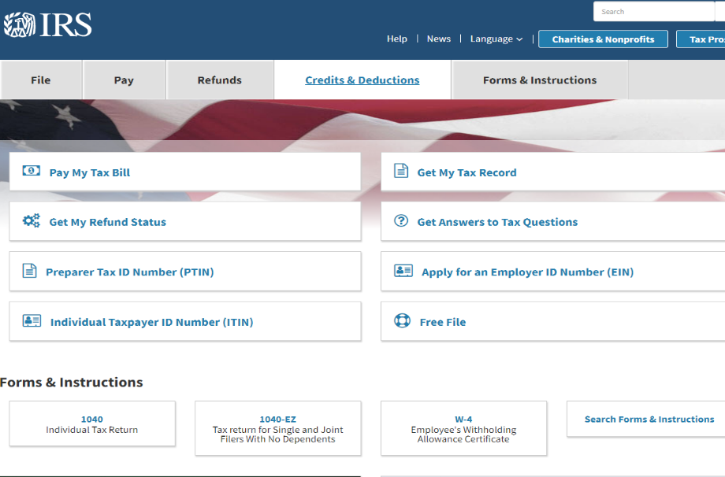
IRS.GOV

Slide 43
How To Find Answers to Your Tax Questions
Google your Question

