Slide 1
2018 tax Cut and Jobs Act how do they affect you
Barbara Harris
Tax Aide Local Coordinator - Counselor
Treasurer – Laguna Woods PC Club
Notes:
This template can be used as a starter file for presenting training materials in a group setting.
Sections
Right-click on a slide to add sections. Sections can help to organize your slides or facilitate collaboration between multiple authors.
Notes
Use the Notes section for delivery notes or to provide additional details for the audience. View these notes in Presentation View during your presentation.
Keep in mind the font size (important for accessibility, visibility, videotaping, and online production)
Coordinated colors
Pay particular attention to the graphs, charts, and text boxes.
Consider that attendees will print in black and white or grayscale. Run a test print to make sure your colors work when printed in pure black and white and grayscale.
Graphics, tables, and graphs
Keep it simple: If possible, use consistent, non-distracting styles and colors.
Label all graphs and tables.

Slide 2
Do you Need to File your taxes

Slide 3
DO I REALLY NEED TO FILE Yes If for 2018 Gross Income was At Least
Single
Under 65 > $12,000
65 and older > $13,600
* ACA Requirement – If under 65 and have no health insurance – Must file
Married Filing Joint
Both Under 65 > $24,000
One 65 Older > $25,300
Both 65 and Older > $26,600

Slide 4
California Filing Requirement
Filing Status | Age as of December 31, 2018* | California Gross Income |  |  | California Adjusted Gross Income
 |  | Dependents |  |  | Dependents
 |  | 0 | 1 | 2 or more | 0 | 1 | 2 or more
Single or head of household | Under 65 | $17,693 | $29,926 | $39,101 | $14,154 | $26,387 | $35,562
 | 65 or older | $23,593 | $32,768 | $40,108 | $20,054 | $29,229 | $36,569
Married/RDP filing jointly or separately | Under 65 (both spouses/RDPs) | $35,388 | $47,621 | $56,796 | $28,312 | $40,545 | $49,720
 | 65 or older (one spouse) | $41,288 | $50,463 | $57,803 | $34,212 | $43,387 | $50,727
 | 65 or older (both spouses/RDPs) | $47,188 | $56,363 | $63,703 | $40,112 | $49,287 | $56,627

Slide 5
Taxable vs. Non Taxable Income
Examples of Non Taxable Income
Insurance Proceeds, Death Payments,
Federal Income Tax Refund, Injury Payments
Gifts, bequests and inheritances
Damage awards for physical injury
Child Support, Welfare Benefits
Reimbursement of qualified adoption expenses
Long Term Care sometimes could be taxable
Refer to IRS.Gov for a complete list

Slide 6
Taxable vs. Non Taxable Income
Examples of Taxable Income
Wages, SS Income, Pensions, Alimony
IRA Distributions, Gambling Winning, Interest, Dividends, Capital Gains, Unemployment
Back Pay, Bonuses and Awards, Rents
Severance Pay, State Tax refund (sometimes)
Cancelled / Forgiven Debt
Non – cash income from bartering
Refer to IRS.Gov for a complete list

Slide 7
Is My Social Security Income Taxable?
Single –
Combined Income $25,000 to $34,000
Up to 50% of Social Security Income is Taxable Income
Combined Income > $34,000
Up 85 % of Social Security Income is Taxable Income
Married Filling Jointly -
Combined Income $ 32,000 to $44,000
Up to 50% of Social Security Income is Taxable Income
Combined Income > $44,000
Up 85 % of Social Security Income is Taxable Income

Slide 8
What is Combined Income
Combined Income =
+½ of your Total Social Security Income
+ Other Income
Wages, Pension, Annuity, Investment Income (Capital Gain, Dividends, etc.) IRA withdrawals, Rental Income, tax exempt interest
Roth IRA withdrawals do not count but bond interest does
= Combined Income

Slide 9
Is My Social Security Taxable Example
Example for Single Person
$14,000 Social Security Benefit
7,000 ½ Social Security
+ 30,000 All other Combined Income
37,000 Total is > $34,000 base
Up to 85 % of the total Social Security or $11,900 will be added to all other taxable income

Slide 10
What Determines My Medicare Premium Based on Your MAGI Modified Adjusted Gross income
Based on MAGI Income from two years ago
MAGI includes all gross income taxable and tax exempt
2017 MAGI Tax Return effects 2019 Premium
$85,000 Single $170,000 Married filing Jointly
Example
You sell a rental and recapture the depreciation or get a huge capital gain in 2016 -
If MAGI exceeds base – 2018 Medicare Premium Increases
https://www.ssa.gov/pubs/EN-05-10536.pdf
Medicare Premiums for Higher Income

Slide 11
Always File If You
Qualify for a refundable credit
Earned Income Credit Under age 65 by 12/31/2018 For Federal
For State no income level – must be earned income – W2 or 1099 Misc.
Are under the age of 65 and do not have health insurance
Received First Time Homeowner credit in 2008 and are continuing to repay the credit

Slide 12
Always File If You
Made estimated tax payments
Had income tax withheld from wages or other distributions
Had carry over loss from previous years
Net Income
> $400 from Self Employment

Slide 13
Now for the changes

Slide 14
2018 Tax Form

Slide 15
2018 Tax Form

Slide 16
2018 Income Tax Rate Changes

Slide 17
2018 TAX CODE CHANGE Increase Standard Deduction Eliminate Exemptions
Standard Deduction Change
Below is for taxpayer over 65
2017 2018
Single Married Single Married
$7,900 $15,200 $ 13,600 $26,600
Refer to IRS.Gov if Under 65
Exemptions – Eliminated 2017 Exemptions
$4,050 Per Person on the Tax Return

Slide 18
2018 Tax Changes Standard Deduction Increases Exemptions Eliminated
2017 2018
Single > 65
Standard Deduction 7,900 13,600
Exemption 4,050 0
Total 11,950 13,600
Married > 65
Standard Deduction 15,200 26,600
Exemption 8,100 0
Total 23,300 26,600

Slide 19
Change Effect if You Previously Itemized
Standard Deductions for over 65
Single Married
$7,900 $15,200
Change to income for taxpayers who itemize
2017 Itemized Deductions
Single Married
Example 10,000 20,000
2017 Exemption 4,050 8,100
Income Reduction 14,050 28,100
2018 Standard Ded 13,300 26,600
Change in Deduction 750 1,500

Slide 20
California Standard Deduction
2018 California Standard Deduction
Single $4,401 Married $8,802
California no longer complies with the Federal Law pertaining to itemized deductions for taxes, mortgage interest ext.
Note: Social Security and interest of Savings Bonds are not considered income in California

Slide 21
Changes to what you can include in your itemized deductions

Slide 22
2018 Changes to Itemized Medical
Itemized Deductions Changes
Medical Deduction subject to 7.5% of AGI
Example $20,000 AGI
$20,000 AGI X 7.5% = $1,500
$3,000 Medical Expenses
- 1,500 75% of AGI
$ 1,500 Amount of allowable deduction.
2019 Medical Deduction is subject to 10% of AGI

Slide 23
Itemized Deductions Changes
Taxes you paid - State and Local Sales tax, income and property taxes can not exceed $10,000 State of California does not agree you are able to deduct all
Mortgage Interest - On Loans up to $750K on made after Dec. 2017 State of California does not agree and allows interest to be deducted on Mortgages over $750K
Interest on Line of Credit not deductible unless the debt is used to build, buy or improve the home – California has same rule
Mortgage Insurance is still Deductible

Slide 24
Itemized Deductions Changes Other
Unreimbursed employee Expenses
Eliminated for Federal – Ok for California
Casualty losses unless related to a Federal Disaster Same for California
Safe Deposit Box Rental, Tax Prep Fee, etc. Advisory Fees
Eliminated For Federal - Ok for California

Slide 25
Other 2018 Tax Code Changes
Medical Insurance – Required for 2018
Eliminated in 2019
Penalty for not having Insurance in 2018
Alimony – 2018 –
Recipient reports Income Payer reports Deduction
For agreements after 12/31/18 – No reporting
Moving Expenses are not deductible
Can no longer Recharacterize Roth Conversions
Student Loan Interest is still deductible
Solar related Energy credits for improvements to your home still deductible but not other Energy Credits

Slide 26
How can I Reduce my tax bill

Slide 27
Reduce Taxable income
If you have a Large Carry forward Loss
IRS only allows $3,000 per year
Market is up – Sell Stock
Example
- 50,000 Carry Forward Loss from Prior Year
You purchased a stock at $50 Value Today is $100 Share sell some shares – apply the gain to the carry forward loss
Note – This must occur in the current tax year 12/31/18

Slide 28
Reduce Taxes You Owe Tax Credits
Tax Credits are better than Tax Deductions
Tax Deductions reduce your Taxable Income
Tax Credits are subtracted from the Taxes you owe
Two types of Credits
Refundable Tax Credits and Non Refundable Credit
Refundable – IRS Pays you even if you don’t owe
Child Tax Credit
Earned Income Credit if under 65 for Federal
State of California 19 + no age limit

Slide 29
Non Refundable Tax Credits
Non Refundable Credits
You have to owe to get the credit
Retirement Savings Credit
Foreign Tax Credit usually appears on your Brokerage Account
Can Not be Carried forward
Use it or loose it in that year
Refer to IRS.gov for complete list

Slide 30
other tax tips

Slide 31
Other Tax Tips
Understand “Taxable Events”
Dividends from Non IRA Brokerage Accounts
Financial Advisors “Churning” Brokerage Account Generating Capital Gains
Receiving a 1099
Rollovers from IRA to Roth
Distribution from IRA’s and Annuities

Slide 32
Other Tax Tips
Avoid Negative Income
Your Standard Deduction and Exemption is more than you Income and your Taxable income is Negative
Example – Married Filing Jointly
15,000 Adjusted Gross Income
-26,600 Standard Deduction
(11,600) Negative Income

Slide 33
Other Tax Tips
Options for Negative Income
Take more IRA Distributions
Sell some Stock that generate a gain
Convert IRA to Roth
Be Careful – there are no more do overs
Note – This must occur in the current tax year, by December 31, 2018

Slide 34
How do I file

Slide 35
NEED TO FILE – HERE ARE SOME WAYS
Utilize Professional Preparer
Enrolled Agent, CPA, HR Block, etc.
Free Filing
IRS.gov or My Free Taxes
< $66,000 on line < $54,000 in person
TCE Program for the Elderly
Handwrite forms
Obtain forms from irs.gov
Tax Software – On Line
Turbo Tax, HR Block, Tax Act, Tax Slayer

Slide 36
Free or Not so Free Tax Software
TurboTax Federal Free Filing Option (Absolute Zero)
Tax slayer.com Free Federal ( Simply Free)
3Smart Tax Free Plan - Liberty Tax – Free Federal
H&R Block Online Free Edition (More Free)
TaxAct Free Edition
FreeTaxUSA Free Edition
IRS Free File Fillable Forms
Notes:
https://www.moneycrashers.com/free-online-tax-preparation-software-services/

Slide 37
Free or Not so Free Tax Software Have Restrictions
Income Limits
Age Limits
Free Federal / Pay for State
Limited Schedules –
No Business Schedule C
No Capital Gains
Etc.
Notes:
https://www.moneycrashers.com/free-online-tax-preparation-software-services/

Slide 38
7 REASONS WHY THE IRS WILL AUDIT YOU
Making Math Errors
You’ll be hit with fines regardless of whether your mistake was intentional
If your math is a little shaky use a Tax Software Program
Failing to Report Income
If the IRS received a form it needs to be reported on your return
Too Many Charitable Deductions
Have documentation for cash donations
Non cash donations must be documented on special form

Slide 39
If you Receive an IRS Notice
Respond immediately to notices
Reference Name and Number on notice
Complete Form 14039 Identity Theft Affidavit
Available at IRS.gov webpage
Remember –
IRS uses US mail to communicate with taxpayer
IRS never uses email or social media
IRS does not call you

Slide 40
need more information

Slide 41
7 REASONS WHY THE IRS WILL AUDIT YOU
Reporting too many Losses on Schedule C
Is this a Business or a Hobby
Reporting too many Work Expenses
Was the purchase absolutely necessary to performing my work duties
Claiming a home office deduction
Home office can qualify if you use it for work and work only
Using nice, neat, round numbers
Round to the nearest whole dollar and not to the nearest 100

Slide 42
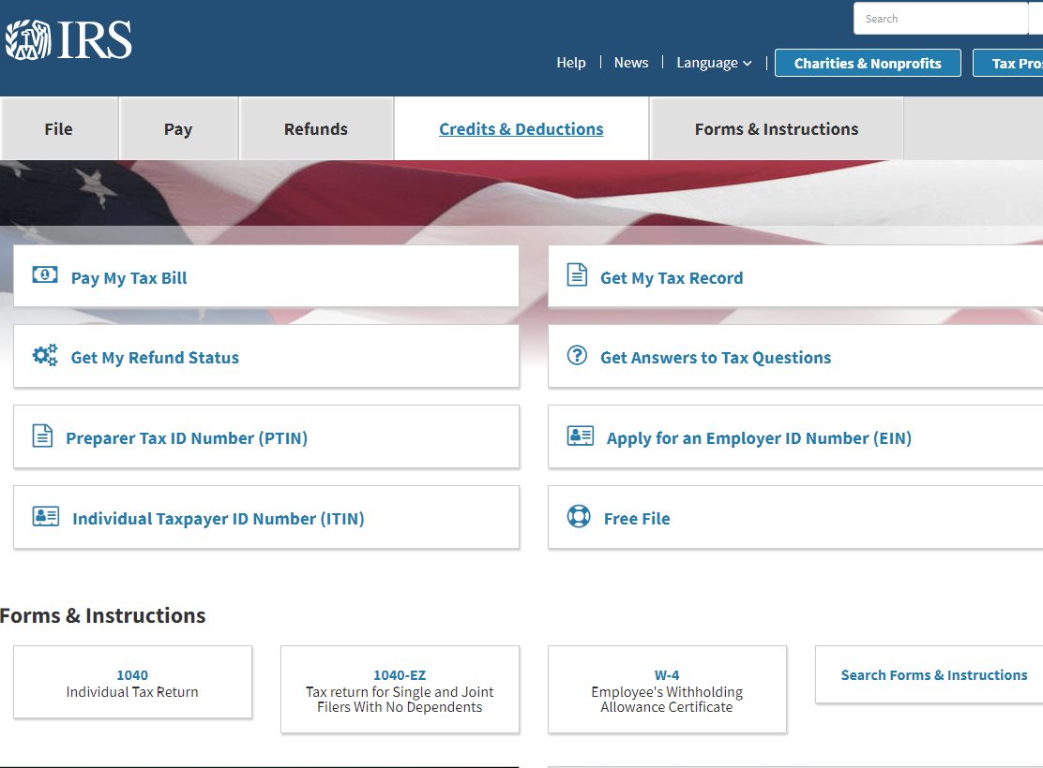
IRS.GOV

Slide 43
How To Find Answers to Your Tax Questions
Google your Question

