Slide 1


PC Club Presentation
Chuck Holland – Information Services Director
March 12, 2024

Slide 2

What is Information Services?
Information Services Division
Resident Services
Information Technology
Community Access

Slide 3
Discussion Points
Introduction to Resident Services
Service Request Escalation Path
2023 Key Performance Indicators
Resident Learning Opportunities
Q&A

Slide 4

Resident Services Contact Information
Monday Through Friday
8:00 AM to 5:00 PM
949-597-4600
ResidentServices@vmsinc.org
www.lagunawoodsvillage.com

Slide 5
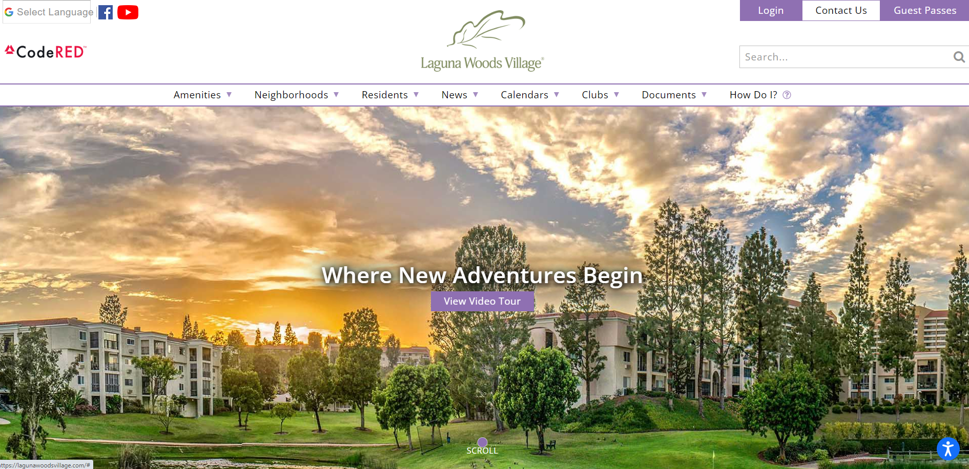
Resident Services Contact Information

Slide 6
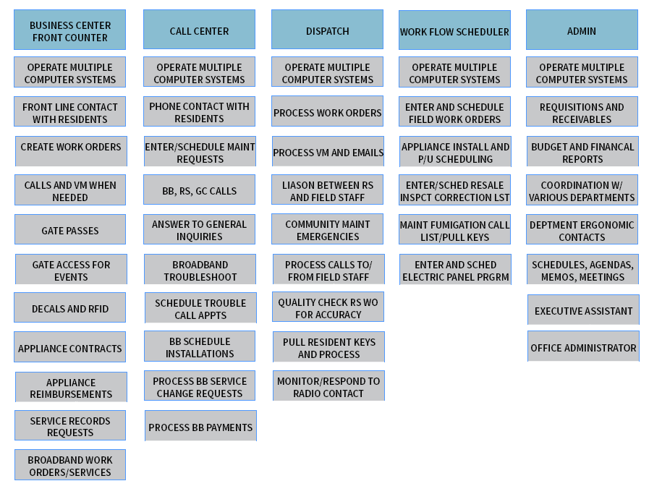
Resident Services Service Areas

Slide 7
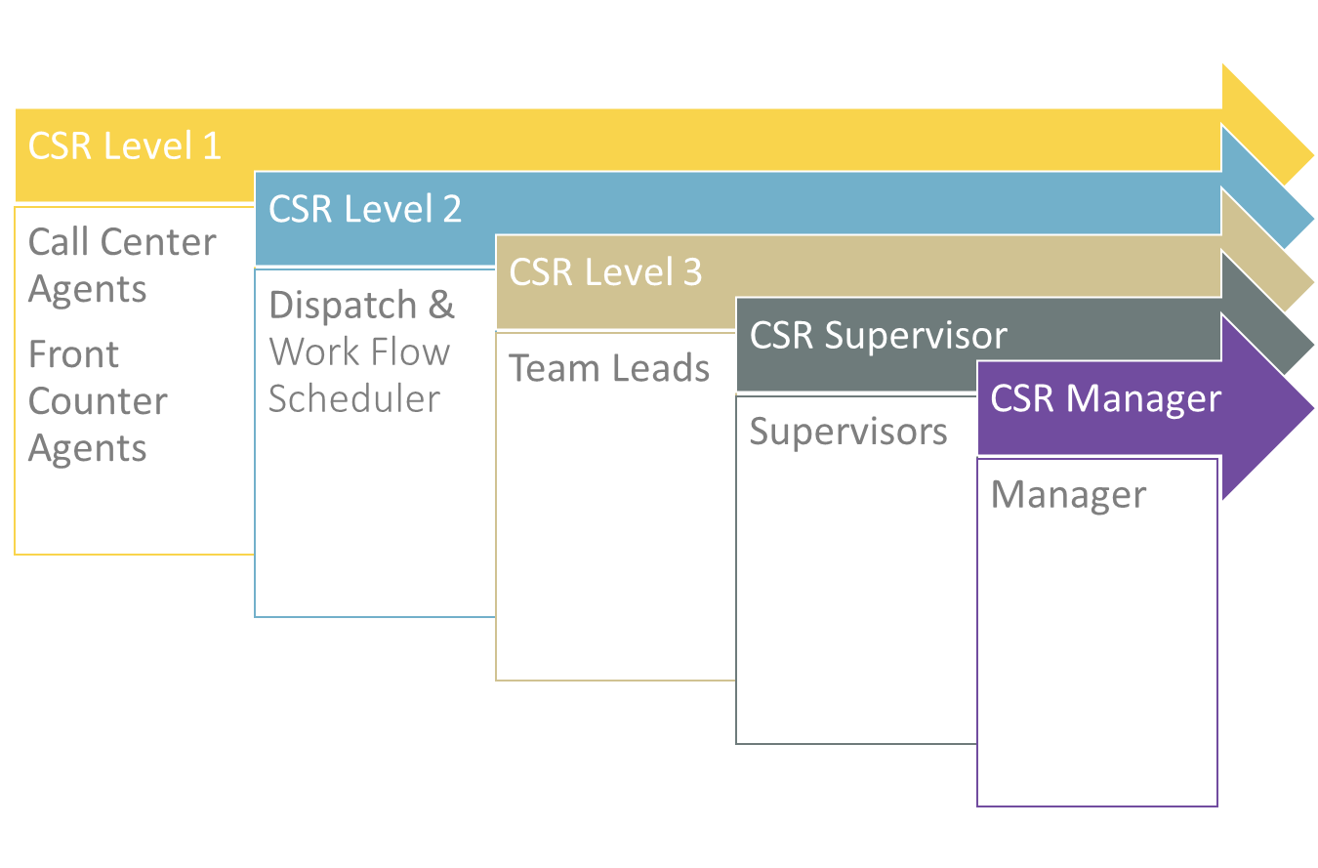
Resident Services Escalation Path

Slide 8

Resident Serivces – 2023 Year End Review

Slide 9
Resident Serivces – 2023 Year End Review
Over 123,000 service calls

Slide 10
Resident Serivces – 2023 Year End Review
Over 50,000 walk-ins

Slide 11
Resident Serivces – 2023 Year End Review
Over 100,000 service requests completed

Slide 12
Resident Serivces – 2023 Year End Review
Over 190,000 gate clearance calls

Slide 13
Resident Serivces – 2023 Year End Review
Over 270,000 guest registrations

Slide 14
Resident Serivces – 2023 Year End Review
Over 1,200,000 guest check-ins

Slide 15
Resident Serivces – 2023 Year End Review
Over 13,000,000 vehicle entries

Slide 16
13,170,165 vehicle entries in 2023!

Slide 17
2024 Objectives?

Slide 18
NEVER Stop Improving!

Slide 19
Thank You

